Slide 1
New Kid on the Block:
Inheriting a Specialty Court

Slide 2
New Kid on the Block:
Inheriting a Specialty Court
Presenters
Judge Raquel “Rocky” Jones
203rd Judicial District Court
Dallas County, Texas
ATLAS – Mental Health & Substance Abuse
Achieving Total Liberty And Success
Judge Lela Lawrence Mays
283rd Judicial District Court
Dallas County, Texas
STAC – Drug Court & Re-entry Court
Successful Treatment of Addiction through Collaboration

Slide 3




The Boy Band

Slide 4


Slide 5


New to the Team
Joining an Existing Specialty Court
Starting at a
New School
Vs.

Slide 6
Remember Your 1st Day at a New School…….
Where will I sit?
Will anybody talk to me?
What will I wear?
Will I know anyone?
What will people say to me?
What questions will they ask me?
Will I know the answers?

Slide 7

Bottom Line….We All Want To….

Slide 8


Where would you sit in the cafeteria?
Cool People Table
New Student

Slide 9
What was your Experience the 1st Day
on a New Specialty Court Team

Slide 10


After Today

Slide 11

New to the Team

Slide 12
Before the 1st Day
Read and Study the program ahead of time
If program is grant funded – know requirements for compliance
Know what you plan to bring to the table
Don’t try to fix everything immediately
Be open and listen to the previous process
Come with your own ideas & life experiences

Slide 13
Know Your Population & Clientele

Slide 14
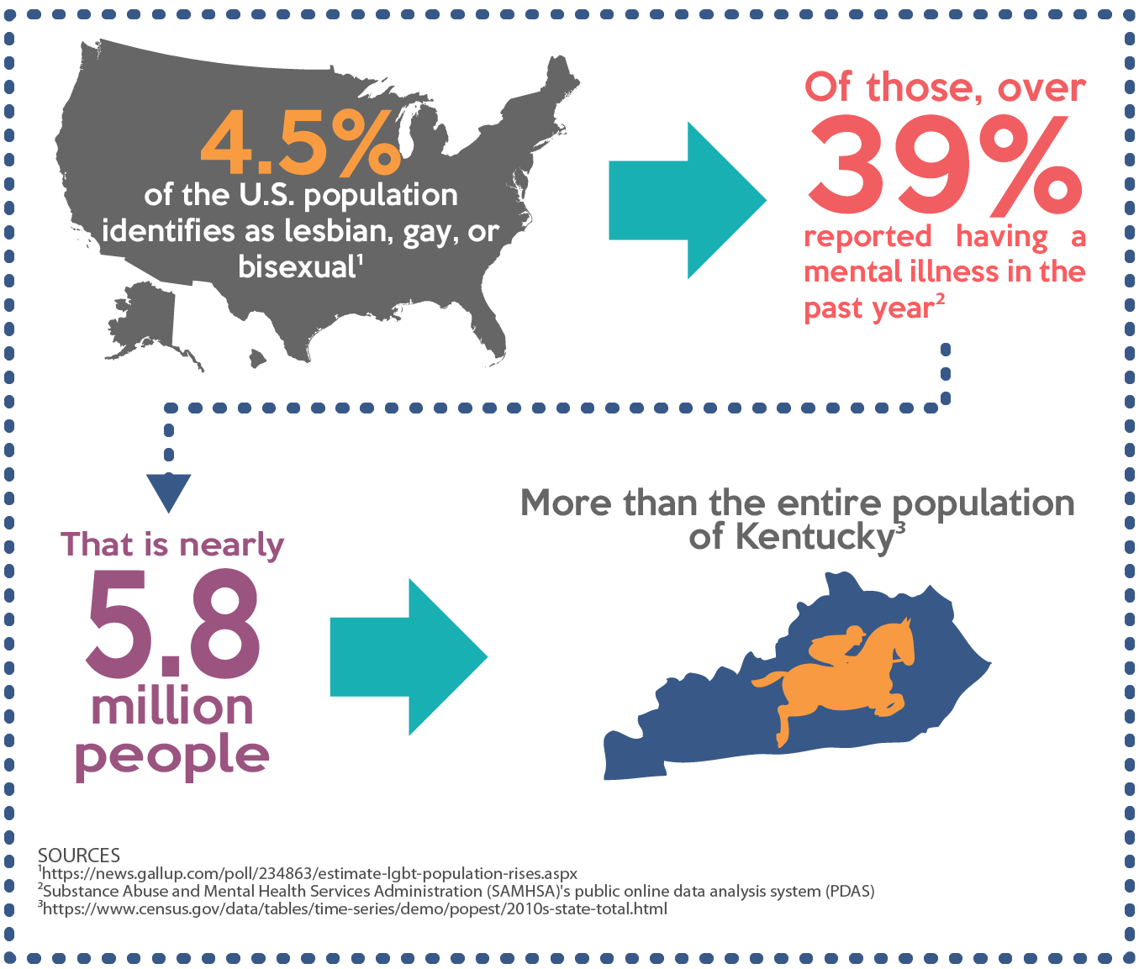

Slide 15
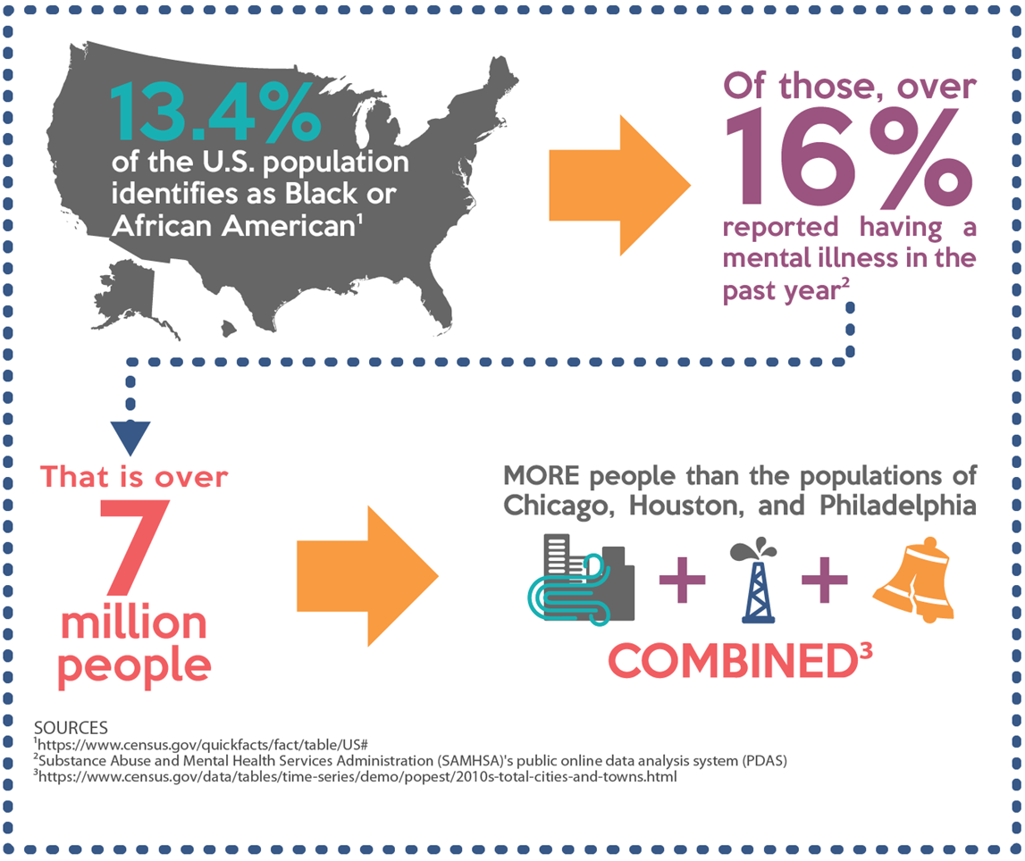

Slide 16
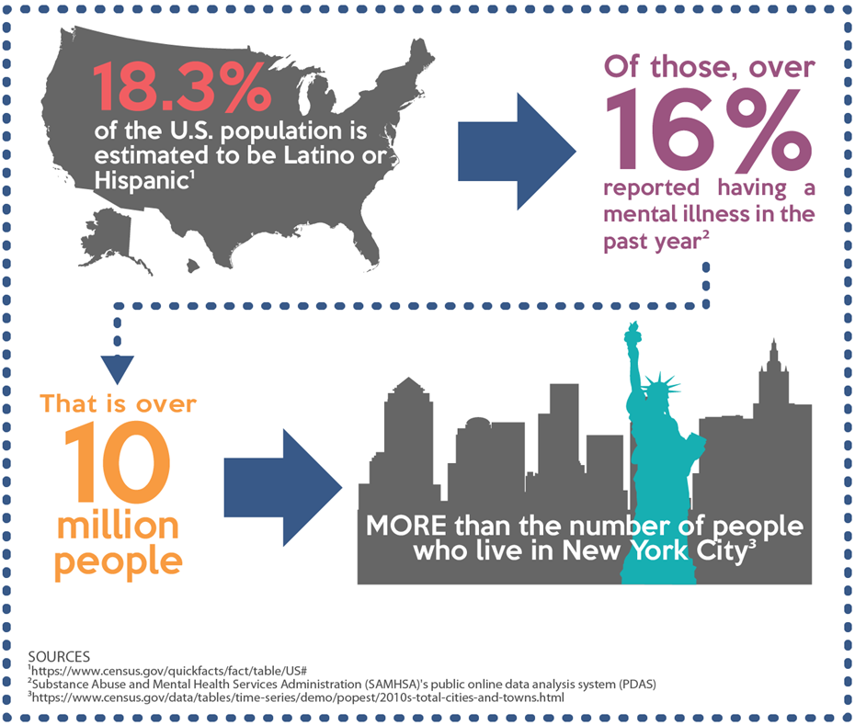

Slide 17
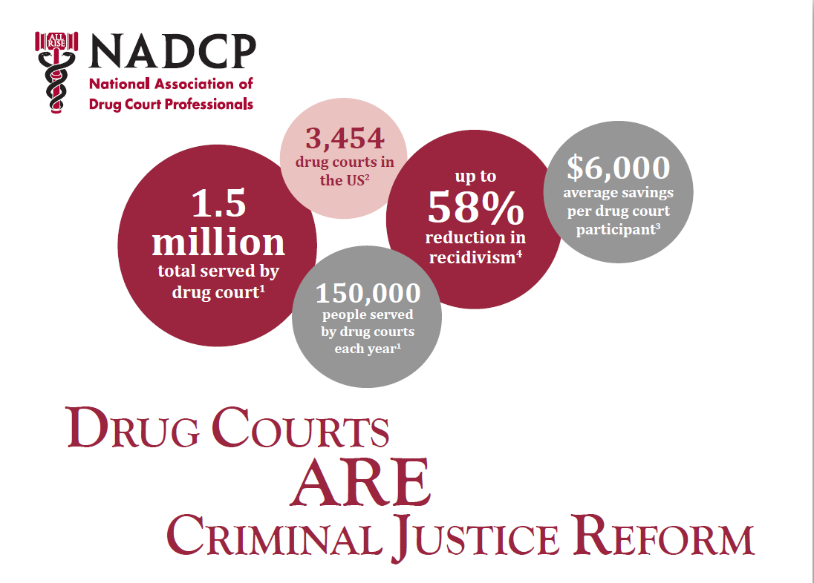
Data provided 2019

Slide 18


Slide 19
The Link Between Substance Abuse & Mental Health
When there is both a substance abuse problem and a mental health issue such as depression, bipolar disorder, or anxiety, it is called a co-occurring disorder or dual diagnosis.
In co-occurring disorders, both the mental health issue and the drug/alcohol addiction have their own unique symptoms.
When a mental health problem goes untreated, the substance abuse problem usually gets worse. And when alcohol or drug abuse increases, mental health problems usually increase too.

Slide 20
The Link Between Substance Abuse & Mental Health
You inherit or take over a new program
Or
You are asked to cover a Specialty Court temporarily
Or
You realize there’s a need to restructure and start over

Slide 21
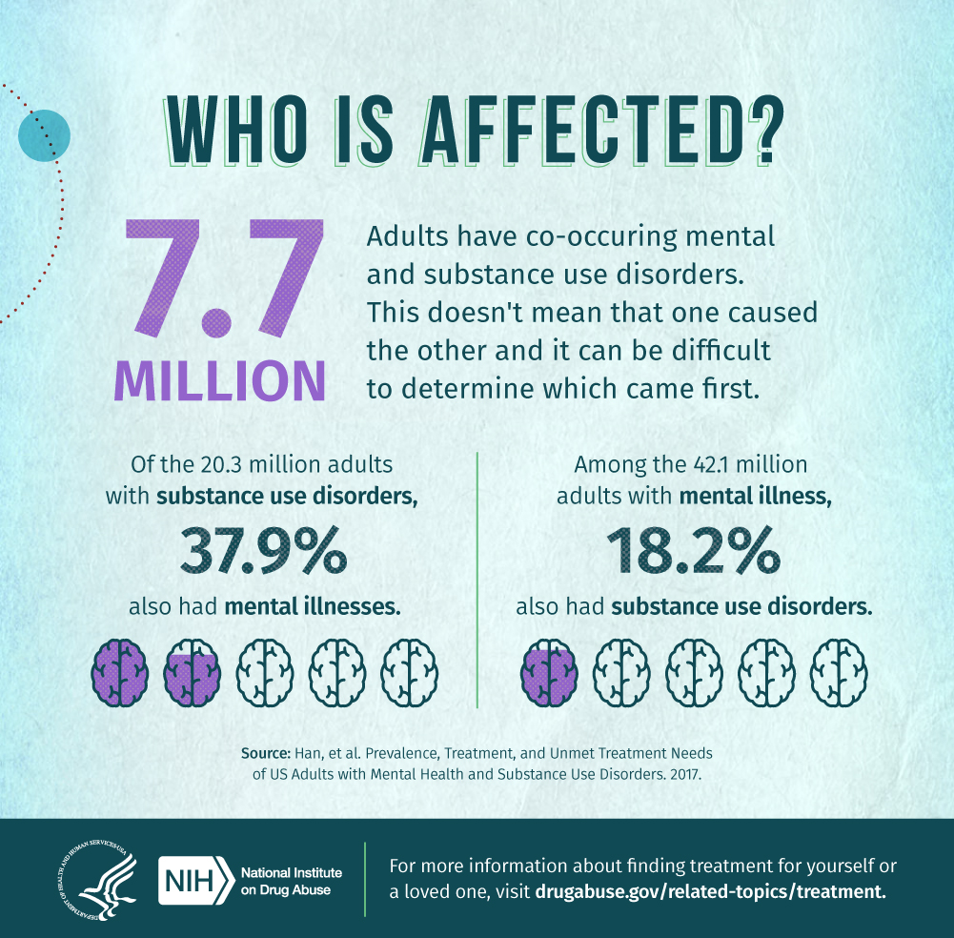

Slide 22
Co-occurring Substance Abuse Problems & Mental Health
More common than many people realize. According to reports published in the Journal of the American Medical Association:
  Roughly 50% of individuals with severe mental disorders are affected by substance abuse.
  37 percent of alcohol abusers and 53% of drug abusers also have at least one serious mental illness.
  Of all people diagnosed as mentally ill, 29% abuse alcohol or drugs.

Slide 23
What comes first: Substance abuse or the Mental Health problem?
Substance abuse and mental health disorders such as depression and anxiety are closely linked, although one doesn’t necessarily directly cause the other. Abusing substances such as marijuana or methamphetamine can cause prolonged psychotic reactions, while alcohol can make depression and anxiety symptoms worse.

Slide 24


Slide 25
Treatment for a Dual Diagnosis
The best treatment is an integrated approach, where both the substance abuse problem and the mental disorder are treated simultaneously:
Treatment for mental health problem may include medication, individual or group counseling, self-help measures, lifestyle changes, and peer support.
Treatment for substance abuse may include detoxification, managing of withdrawal symptoms, behavioral therapy, and support groups to help maintain sobriety.

Slide 26
Creating the Right Treatment Program
Make sure that the program is appropriately licensed and accredited, the treatment methods are backed by research, and there is an aftercare program to prevent relapse. These are some basics of effective treatment that you should look for:
  Treatment addresses both the substance abuse problem and mental health problem.
  The team shares in the decision-making process and are actively involved in setting goals and developing strategies for change.
  Treatment includes basic education about disorder and related problems.
  Teaching healthy coping skills and strategies to minimize substance abuse, strengthen relationships, and coping with life’s stressors, challenges, and upsets.

Slide 27
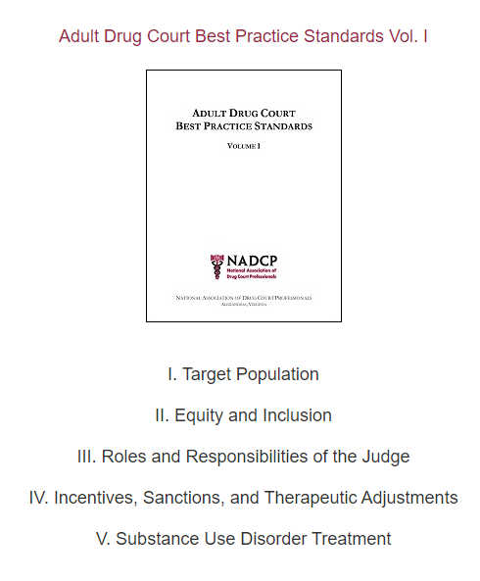

Slide 28
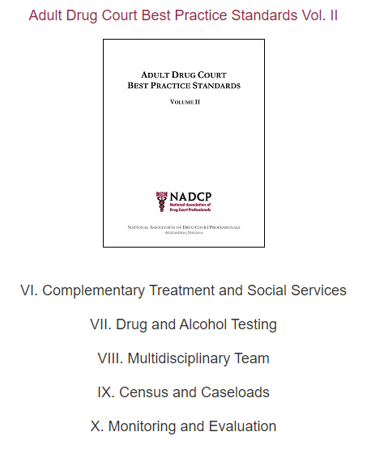

Slide 29
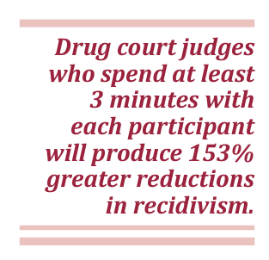
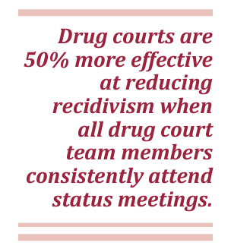
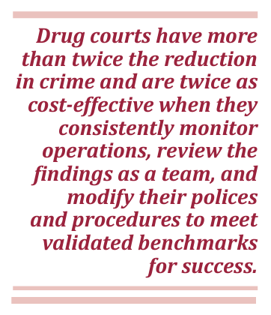

Slide 30
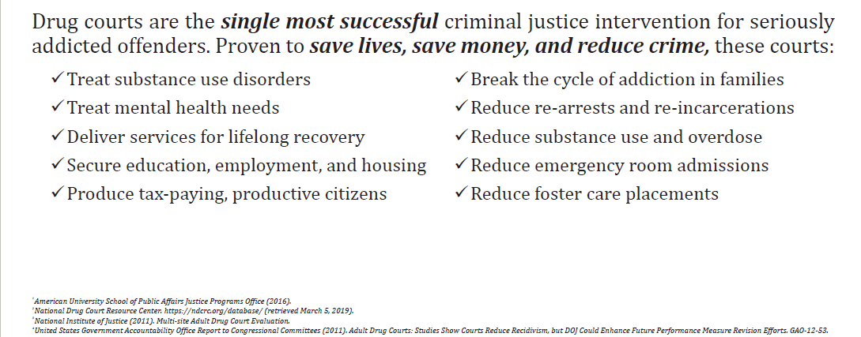

Slide 31


How do you maintain the success of
the program ?
What happens if you come to a program that does not
have structure or consequences?

Slide 32
Progressive Sanctions
Failure to report for orientation
  1st Violation – verbal warning
  2nd Violation – returned to original court – discharge from program
Failure to call the UA line/Failure to Provide UA
  1st Violation – verbal warning (court UA)
  2nd Violation –additional NA meetings
  3rd Violation – community service
  4th Violation – days in jail
  5th Violation – discharge from program

Slide 33
Progressive Sanctions
Failure to report to Court Sessions
  1st Violation – verbal warning
  2nd Violation – community service
  3rd Violation – days in jail
  4th Violation – revocation
Failed Drug Test
  1st Violation – admonishment & additional NA meetings
  2nd Violation – community service & drug patch
  3rd Violation – days in jail
  4th Violation – in patient treatment
  Continued Violations – revocation

Slide 34
Practical Tips
Create/Review Program Guidelines – Do’s & Don'ts
What will be your maximum number of clients
Meet with probation officers to determine requirements for success
Develop Graduated sanctions
What are the rewards – certificates, milestones, graduation, etc.
What is the ultimate goal of your program
If possible-visit facilities and review curriculum offered to clients
What is your threshold of tolerance – NON-NEGOTIABLES
Accept & Meet the clients where they are in life – Be Relatable

Slide 35

Lastly……..

Slide 36



Slide 37

Architect of Specialty Court……Then

Slide 38
Then……
You inherit or take over a new program
Or
You are asked to cover a Specialty Court temporarily
Or
You realize there’s a need to restructure and start over

Slide 39

Before getting started…
…of the Program

Slide 40
Review & Gather Your Documents:
Intake Packets
Policy & Procedures for Staff
Handouts/Brochures for clients
  Do all paperwork, documents and handouts match?
Waivers
  Waivers to collaborate with outside agencies
  Waivers to discuss with progress with family members

Slide 41
Review Client Documents:
Any Assessments
Family History
Criminal History
Drug History
Treatment History

Slide 42
Observe & Ask Questions
After court session, discuss with team what you observed
Is the team diverse in race, gender and cultural experience
Why things were done in a certain way
The history behind certain decisions and actions
Discuss best practices
What can be done to enhance the program

Slide 43
Look for the Following:
Who has come through the program?
Who was successful and who was not…and why not?
Who is currently in the program?
What are their risk levels?
How are they separated in treatment:
  Gender
  Age
  Education level (help for those with learning difficulties)
What are the drugs of choice?
What is the drug history?

Slide 44
Working with the Clients:
Who has come through the program?
Requirements of the participants
Test for the correct drugs
  Run a “nurses panel” or K2 test, when necessary
Consider testing on……
  Birthdays, weddings, travel, weekends, the Superbowl, World Cup, World Series, etc.
What’s important to the participant?
Utilize alumni for support and to inform the team of community events or concerns that may arise

Slide 45
Look at Vendors/Providers:
Who are the vendors / treatment providers?
How many are affiliated with the program?
What services do they provide?
Are outcomes shared with the team?
How is the information disseminated to the team?
Visit the facility or observe a session
  What is the curriculum?
  What is the population? – restricted to drug court, criminal justice, education level
  Are progress reports and violations provided immediately, weekly or monthly?
Does a representative attend staffing?

Slide 46

Is it time for a change ?

Slide 47
Does the program need to be tweaked?
Does it follow best practices?
Is the program up to date?
Are the rules evenly & consistently followed ?
How is program working as related to outcomes?

Slide 48
Training
In-house
Local or Online
Arrange for team to attend TASC trainings – Stipends
Bring in NADCP trainers and material
Provide updates by email when necessary
Newsletters from TASC, NADCP and other publications
Self-Care :
  Take care of your Team
  Take care of your Self

Slide 49

The Zoom World

Slide 50
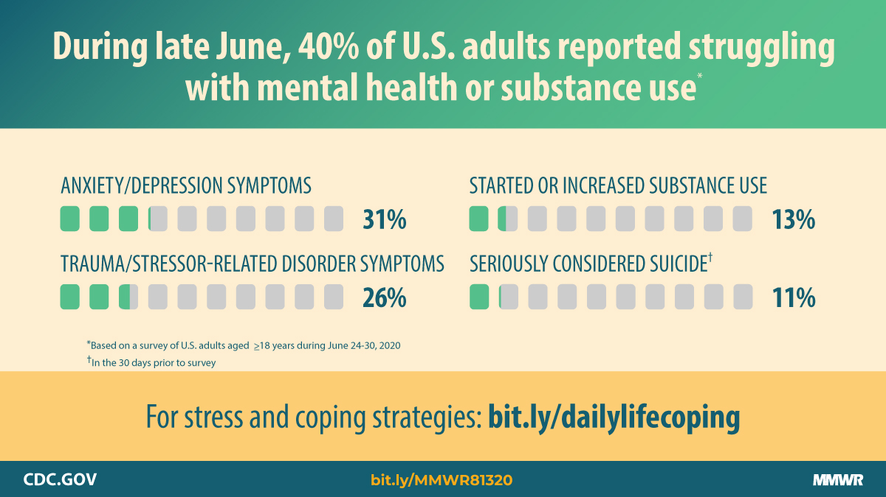

Slide 51
Online Court Meetings
Keep your eyes on your clients at every court session – Zoom or in-person
Pay attention to body language at each court session – Practice makes perfect….or pretty close
Require certain participants to appear in person

Slide 52
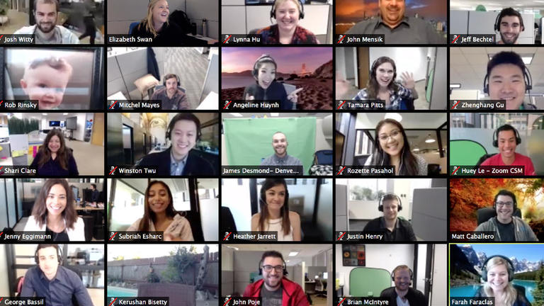

Slide 53



Securing and Retaining Participants
Vs.
Pre-Pandemic
Post-Pandemic

Slide 54


Slide 55


Slide 56
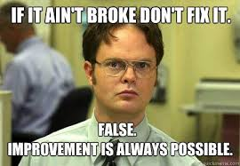
Most Programs Are Already A Success
True or False

Slide 57
ANSWER:

Slide 58

Any Questions ????

Slide 59


Slide 60

Thank You
Judge Raquel “Rocky” Jones
203rd Judicial District Court
133 N. Riverfront Blvd.
Dallas, Texas 75207
Rocky.jones@dallascounty.org
Judge Lela Lawrence Mays
283rd Judicial District Court
133 N. Riverfront Blvd.
Dallas, Texas 75207
Lela.mays@dallascounty.org

